Slide 1

Themes and Styles
CIS 399
Android Material Design Wallpaper

Slide 2
Course Overview
Wk | Topic
1 | Intro, single-screen apps
1 | Activity Lifecycle, saving activity state
2 | Layouts + widgets, Event Handlers
2 | Themes + styles, Menus + settings
2 | Multi-screen apps,
Wk | Topic
3 | Fragments
3 | Reading XML files, Asynch Tasks
3 | List Views
3 | SQLite Database
4 | Consuming a web service
4 | Geolocation

Slide 3
What You Need to Know
What styles and themes are:
A Style is a collection of properties applied to a view (widget or layout)
A theme is a collection of properties applied to an activity or an app
What effect they have on your app:
They affect the appearance, but not the functionality
How to use them in your app
Add a style attribute to an XML layout element
Add a theme attribute to an activity or application element in the manifest
Notes:
https://developer.android.com/guide/topics/ui/themes.html

Slide 4
Create a Style
Open your project's res/values/styles.xml file.
Add a <style> element with a name that uniquely identifies the style.
Add an <item> element for each style attribute you want to define. For example, if you define the following style:
<?xml version="1.0" encoding="utf-8"?> <resources> <style name="GreenText" parent="TextAppearance.AppCompat"> <item name="android:textColor">#00FF00</item> </style> </resources>
Notes:
https://developer.android.com/guide/topics/ui/look-and-feel/themes

Slide 5
Use a Style
You can apply the style to a view as follows:
<TextView style="@style/GreenText" ... />

Slide 6
Apply a Theme
Apply a theme to the whole app:
<manifest ... > <application android:theme="@style/Theme.AppCompat" ... > </application> </manifest>
Apply a theme to just one activity:
<manifest ... > <application ... > <activity android:theme="@style/Theme.AppCompat.Light" ... > </activity> </application> </manifest>
Notes:
https://developer.android.com/guide/topics/ui/look-and-feel/themes#Theme

Slide 7
Customize the Default Theme
When you create a project with Android Studio, it applies a material design theme to your app by default, as defined in your project's styles.xml file.
This AppTheme style extends a theme from the support library and includes overrides for color attributes For example, your styles.xml file should look similar to this:
<style name="AppTheme" parent="Theme.AppCompat.Light.DarkActionBar"> <!-- Customize your theme here. --> <item name="colorPrimary">@color/colorPrimary</item> <item name="colorPrimaryDark">@color/colorPrimaryDark</item> <item name="colorAccent">@color/colorAccent</item> </style>
Notes:
https://developer.android.com/guide/topics/ui/look-and-feel/themes#Theme

Slide 8
Common Themes

Slide 9
Notes:
Three common themes, and the ones used in the textbook

Slide 10
Material Design
Material design is a comprehensive guide for visual, motion, and interaction. To use material design in your Android apps, follow the guidelines described in the material design specification and use the components and functionality available in Android 5.0, Lollipop (API level 21) and newer.
Material design apps have the following elements:
The material theme
Widgets for cards and lists
Custom shadows and view clipping
Vector drawables
Custom animations
Notes:
https://developer.android.com/training/material/index.html

Slide 11
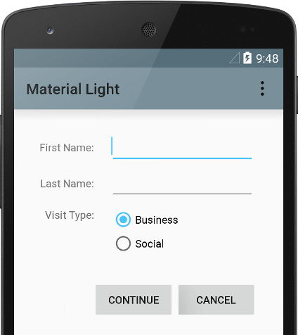
Material Theme
The material theme provides:
System widgets that let you set their color palette
Touch feedback animations for the system widgets
Activity transition animations

Slide 12
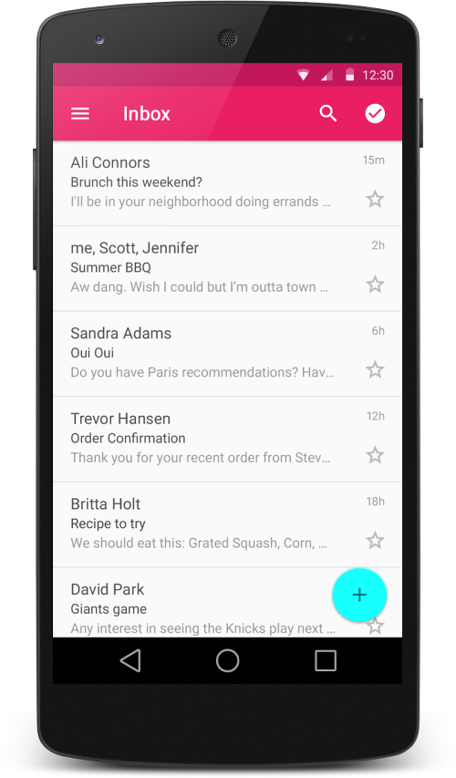
New Type of List View
The RecyclerView class simplifies the display and handling of large data sets by providing:
Layout managers for positioning items
Default animations for common item operations, such as removal or addition of items

Slide 13
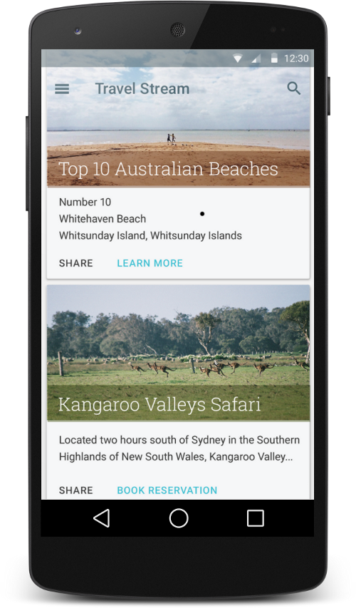
Cards
CardView extends the FrameLayout class and lets you show information inside cards that have a consistent look across the platform. CardView widgets can have shadows and rounded corners.

Slide 14
Elevation: Shadows and Movement
Material design introduces elevation for UI elements.
Elevation helps users understand the relative importance of each element
The elevation of a view, represented by the Z property, determines the visual appearance of its shadow
Views with higher Z values cast larger, softer shadows
Views with higher Z values occlude views with lower Z values
Elevation can be used to create animations where widgets temporarily rise above the view plane when performing some action.

Slide 15
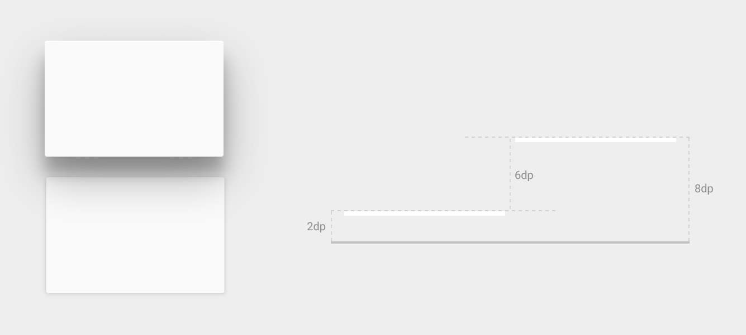
Shadows for Two View Elevations

Slide 16
Custom Animations
Animations in material design give users feedback on their actions. The material theme provides some default animations for buttons and activity transitions, and Android 5.0 (API level 21) and above lets you customize these animations and create new ones:
Touch feedback
Circular Reveal
Activity transitions
Curved motion
View state changes
Notes:
Reveal animations provide users visual continuity when you show or hide a group of UI elements. The ViewAnimationUtils.createCircularReveal() method enables you to animate a clipping circle to reveal or hide a view.

Slide 17
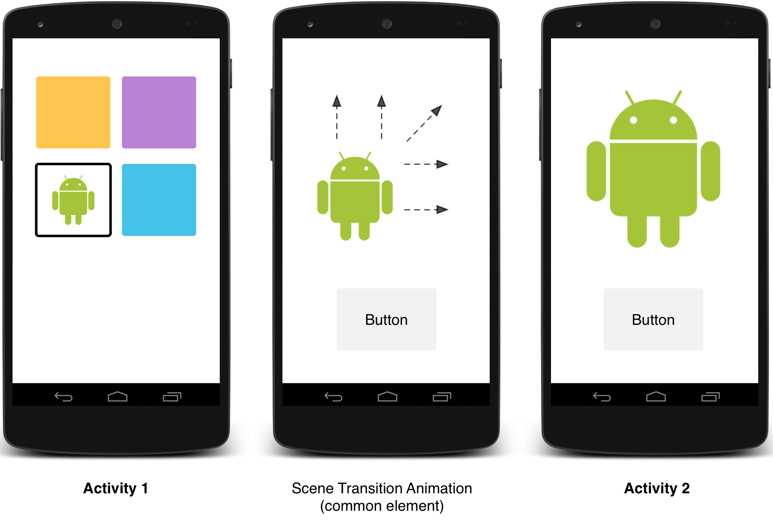
Scene Transition with One Shared Element

